Slide 1

White Box Testing
Text Book : “Software Engineering: A Practitioner’s approach ” by R. Pressman

Slide 2



What is White-box Testing?
Basic idea is to test a program based on the structure of a program.
White box testing is a test case design method that uses the control structure of the procedural design to derive test cases.
Derivation of test cases according to program structure. Knowledge of
the program is used to identify additional test cases
Objective is to exercise all program statements (not all path combinations)
Test cases can be derived that
guarantee that all independent paths within a module have been exercised at least once,
exercise all logical decisions on their true and false sides,
execute all loops at their boundaries and within their operational bounds, and
exercise internal data structures to ensure their validity.

Slide 3






Cont’d..
Typically done during unit testing
Also known as:
Structural Testing
Glass-Box Testing
Clear Box Testing
Test data
Tests
Derives
Component code
Test
outputs

Slide 4

Types
Dynamic white box testing
Looking into the program, executing the code, watching it running.
Static white box testing
Testing a program without running it, meaning examining and
reviewing it.
It is the process of carefully and methodically reviewing the software design, architecture or code for bugs without executing it.
Also called structural analysis

Slide 5



White-Box Testing Objectives
The Major objective of white-box testing is to focus on internal program structure, and discover all internal program errors.
The major testing focuses:
Program structures
Program statements and branches
Various kinds of program paths
Program internal logic and data structures
Program internal behaviors and states.

Slide 6



Traditional White Box-Based Software Testing
Test Model: control program chart (graph)
Test case design:
Various white-box testing methods generate test cases
based on a given control program graph for a program
The goal is to:
Guarantee that all independent paths within a module have been exercised at least once.
Exercise all logical decisions one their true and false sides.
Execute all loops at their boundaries and within their operational bounds.
Exercise internal data structures to assure their validity.
Exercise all data define and use paths.

Slide 7


White-box Test Methods
Statement Coverage
Decision/Branch Coverage
Condition Coverage
Path Coverage

Slide 8

Statement Coverage
The measure reports on the percentage of executable statements of the code exercised by a set of test cases. Also known as basic block coverage or segment coverage.
The major advantage of this measure is that it can be applied directly to object code and does not require processing source code. Performance profilers commonly implement this measure.
The major disadvantage of statement coverage is that it is insensitive to some control structures

Slide 9

Statement Coverage Comments
Statement coverage does not report whether loops reach their termination condition - only whether the loop body was executed.
Since do-while loops always execute at least once, statement coverage considers them the same rank as non- branching statements.
Statement coverage is completely insensitive to the logical decisions.
Statement coverage requires in most cases very few test cases to achieve. Not acceptable to release code based on statement coverage alone.

Slide 10

Statement Coverage Examples
if(A) then
F1();
F2();
Test Case: A=True Statement Coverage achieved
int* ptr = NULL; if (B)
ptr = &variable;
*ptr = 10;
Test Case:
B=True
Statement Coverage
Achieved
Problem : if B is false the code will fail with a null pointer exception.

Slide 11

Decision Coverage
Decision coverage (also known as branch coverage, all- edges coverage, basis path coverage, decision-decision- path testing) reports whether Boolean expressions in control structures are evaluated to both true and false values by the test cases.
Note in decision coverage we are not interested in all combinations of True/False values of all program predicates.
The entire Boolean expression is considered one true-or-
false predicate.
Additionally, this measure includes coverage of switch- statement cases, exception handlers, and interrupt handlers.

Slide 12

Decision Coverage Examples
if(A)
F1();
else
F2();
if(B)
F3()
else
F4();
Test Cases for Decision Coverage:
A=T, B=T
A=F, B=F
if (A && (B || F1())) F2();
else
F3();
Test Cases for Decision Coverage: A=T, B=T
A=F
Problem: F1() never gets called. This problem occurs in languages with short circuiting boolean operators

Slide 13

Decision Coverage Comments
This measure has the advantage of simplicity without the problems of statement coverage.
A disadvantage may produce gaps in tested code in programs written in languages that have short-circuit logic operators (C, C++, Java etc.)

Slide 14

Condition Coverage
Condition coverage reports the true or false outcome of each Boolean sub-expression.
Condition coverage measures the sub-expressions
independently of each other.
This measure is similar to decision coverage but has better sensitivity to the control flow.
An extension of Condition Coverage is the Condition/Decision Coverage which is a hybrid measure composed by the union of condition coverage and decision coverage. It has the advantage of simplicity but without the shortcomings of its component measures.

Slide 15

Condition Coverage Examples
if(A && B)
F1();
else
F2();
if(C)
F3()
else
F4();
Test Cases for Condition Coverage: A=T, B=T, C=F
A=F, B=F, C=T

Slide 16

Multiple Condition Coverage
Multiple condition coverage reports whether every possible combination of boolean sub- expressions occurs.
The test cases required for full multiple condition coverage of a condition are essentially given by the logical operator truth table for the condition.

Slide 17
Multiple Condition Coverage Examples
if(A && B) // condition 1 F1();
else
F2();
if(C || D)// condition 2 F3()
else
F4();
Test Cases for MCC:
For condition 1 A=T, B=T
A=T, B=F A=F, B=T A=F, B=F
For condition 2 C=T, D=T
C=T, D=F C=F, D=T C=F, D=F

Slide 18
Multiple Condition Coverage Comments
For languages with short circuit operators multiple condition coverage is very similar to condition coverage (but with more test cases).
For languages without short circuit operators multiple condition coverage is effectively path coverage.
A disadvantage of this measure is that it can be tedious to determine the minimum set of test cases required, especially for very complex Boolean expressions.
An additional disadvantage of this measure is that the number of test cases required could vary substantially among conditions that have similar complexity. Consider a && b && (c || (d && e)) and the ((a || b) && (c || d)) && e [1]
As with condition coverage, multiple condition coverage does not include decision coverage.

Slide 19

Modified MCC
Also known as MC/DC and MCDC.
This measure also known as MC/DC and MCDC requires enough test cases to verify every condition can affect the result of its encompassing decision.
For C, C++ and Java, this measure requires exactly the same test cases as condition/decision coverage.
Modified condition/decision coverage was designed for languages containing logical operators that do not short- circuit.
The short circuit logical operators in C, C++ and Java only evaluate conditions when their result can affect the encompassing decision.

Slide 20

Modified MCC Examples
To test if A: | (A T | or F | B) | F
B: | F | T |  | F
To test if A: | (A F | and B) T |  | T
B: | T | F |  | T
To test if A: | (A T | xor B) T |  | F
B: | T | F |  | T

Slide 21

Path Coverage or Path Testing
Path testing is a structural testing method that involves using the source code of a program to attempt to find every possible executable path. The idea is that we are then able to test each individual path in as many ways as possible in order to maximize the coverage of each test case.
Path testing is the name given to a group of test techniques based on judiciously selecting a set of independent test paths through the program. If the set of paths is properly chosen, then it means that we have achieved some measure of test thoroughness.
This type of testing involves:
generating a set of independent paths that will cover every branch in the program.
finding a set of test cases that will execute every path in the set of program paths.

Slide 22

Flow Graph
The control flow of a program can be analyzed using a graphical representation known as flow graph. The flow graph is a directed graph in which nodes are either entire statements or fragments of a statement, and edges represents flow of control.
A simple notation for the representation of control flow, called a flow graph (or program graph).
The flow graph depicts logical control flow using the notation illustrated in Figures on next slide.

Slide 23
Program Flow Graph (Control Flow Diagram)
C
If C Then S1 else S2;
Sequential statement block
S1
S2
C
Case C of
C
L1: S1;
L2: S2;
…
Kn: Sn; end;
If C Then S1;
S1
Sn
S1

Slide 24
Program Flow Graph (Control Flow Diagram)
I = 1
C
For loop:
While C do S;
for I = 1 to n do S;
F
S
S
T
yes
I <=n
no
S1
Do loop:
do S1 until C;
F
C
T

Slide 25

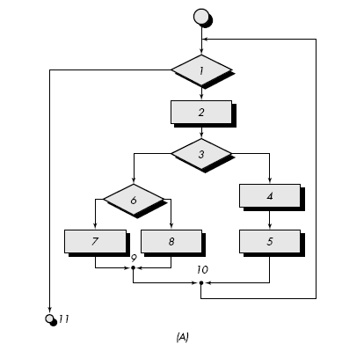
Flow Graph Notation Cont’d…
Each structured construct has a corresponding flow graph symbol.
To illustrate the use of a flow graph, we consider the procedural design representation in the following Figure (A):
Figure(A) represents the Flowchart.

Slide 26

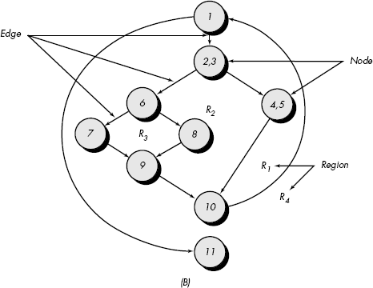
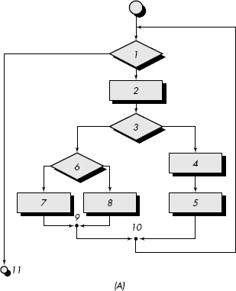
Figure (B): Flow Graph

Slide 27

Description of Flow Graph
Figure B maps the flowchart into a corresponding flow graph (assuming that no compound conditions are contained in the decision diamonds of the flowchart).
Referring to Figure (B), each circle, called a flow graph node, represents one or more procedural statements.
A sequence of process boxes and a decision diamond can map into a single node.
The arrows on the flow graph, called edges or links, represent flow of
control and are analogous to flowchart arrows.
An edge must terminate at a node, even if the node does not represent any procedural statements
Areas bounded by edges and nodes are called regions.
When counting regions, we include the area outside the graph as a region.

Slide 28
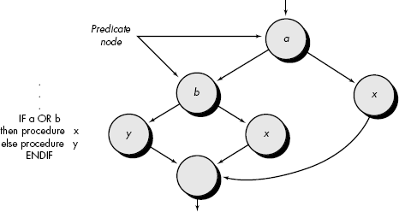
Description of Flow Graph
When compound conditions are encountered in a procedural design, the generation of a flow graph becomes slightly more complicated.
Each node that contains a condition is called a predicate node and
is characterized by two or more edges emanating from it.

Slide 29

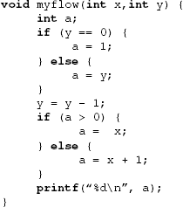
Example Code Fragment

Slide 30

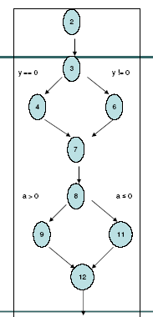
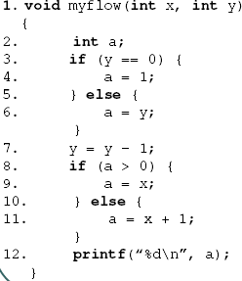
Example Control Flow Graph

Slide 31

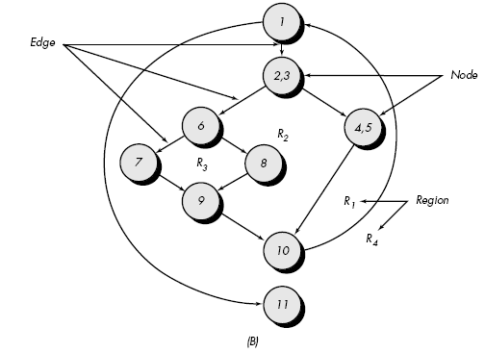
Independent Path
An independent path is any path through the program that introduces at least one new set of processing statements or a new condition.
When stated in terms of a flow graph, an independent path must move along at least one edge that has not been traversed before the path is defined.
For example, a set of independent paths for the flow graph illustrated in Figure B is
path 1: 1-11
path 2: 1-2-3-4-5-10-1-11
path 3: 1-2-3-6-8-9-10-1-11
path 4: 1-2-3-6-7-9-10-1-11

Slide 32

Cont’d…
Note that each new path introduces a new edge.
The following path:
1-2-3-4-5-10-1-2-3-6-8-9-10-1-11
is not considered to be an independent path because it is simply a combination of already specified paths and does not traverse any new edges.
Paths 1, 2, 3, 4 and 6 constitute a basis set for the flow graph in Figure B That is, if tests can be designed to force execution of these paths (a basis set), every statement in the program will have been guaranteed to be executed at least one time and every condition will have been executed on its true and false sides.
It should be noted that the basis set is not unique. In fact, a number of different basis sets can be derived for a given procedural design.
How do we know how many paths to look for? The computation of cyclomatic complexity provides the answer.

Slide 33
Consider the problem for the determination of the nature of roots of a quadratic equation. Its input a triple of positive integers (say a,b,c) and value may be from interval [0,100].
The output may have one of the following words:
[Not a quadratic equation; real roots; Imaginary roots; Equal roots]
Draw the flow graph and DD path graph. Also find independent paths from the DD Path graph.

Slide 34
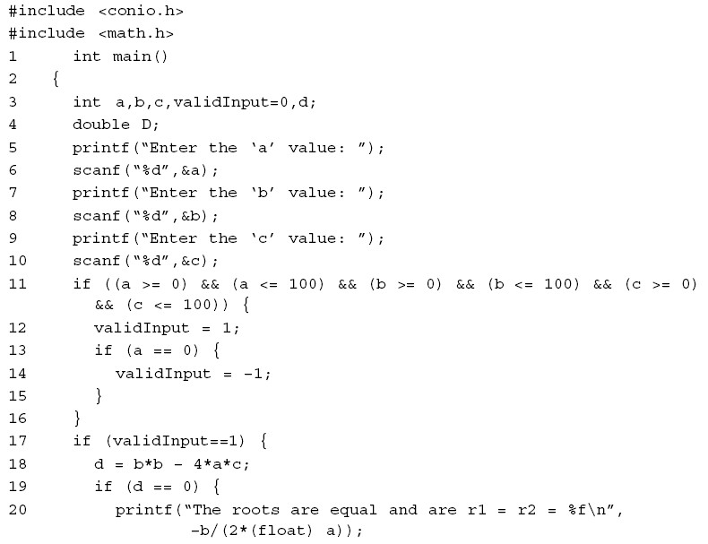
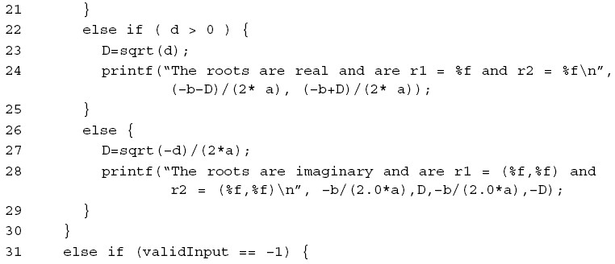
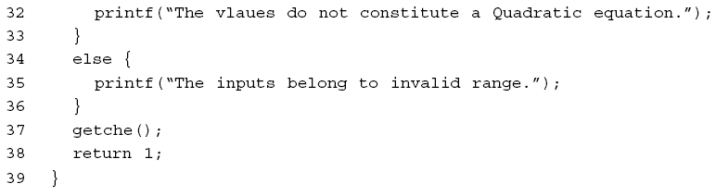

Slide 35
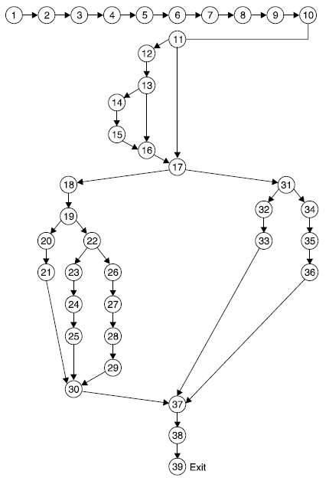
Program flow graph

Slide 36
Cont’d..
A program graph provides us with some interesting details about the structure of a piece of code.
In the previous example graph, we can see that nodes 2 through to 10 and nodes 14 to 15 are sequences.
This means that these nodes represent simple statements such as variable declarations, expressions or basic input/output commands.
Nodes 11 through to 17 are a representation of an if-then-
else construct.
While nodes 1 and 39 are the source and sink nodes of the program respectively.
By examining a program graph, a tester can garner an important piece of information; is the program structured or unstructured?

Slide 37

DD path graph
Program graphs play such an important role in structural testing is due to the fact that they form the basis of a number of testing methods, including one based on a construct known as decision-to- decision paths (more commonly referred to as DD-Paths)
The idea is to use DD-Paths to create a condensation graph of a piece of software’s program graph, in which a number of constructs are collapsed into single nodes known as DD-Paths.
DD-Paths are chains of nodes in a directed graph that adhere to
certain definitions.
Each chain can be broken down into a different type of DD-Path, the result of which ends up as being a graph of DD-Paths.

Slide 38

Cont’d…
The definitions of each different type of DD-Path that a chain can be
reduced to are given as follows:
Type 1: A single node with an in-degree = 0.
Type 2: A single node with an out-degree = 0.
Type 3: A single node with in-degree >= 2 or out-degree >= 2.
Type 4: A single node with in-degree = 1 and out-degree = 1.
Type 5: The chain is of a maximal length >= 1.
Type 1 and Type 2 are needed to provide us with the capability of
defining these key nodes as initial and final DD-Paths.
Type 3 deals with slightly more complex structured constructs that often appear in a program graph such as If-Then-Else statements and Case statements.
Type 4 allows for basic nodes such as expressions and declarations to be defined as DD-Paths.
Type 5 is used to take chains of these nodes and condense them into a single node.

Slide 39

Steps
Flow graph is the first step of path testing
Second step is to generate Decision to Decision (DD) path graph from the flow graph
Construction is on decision node
It is a directed graph in which nodes are sequences of statements and edges represent control flow between nodes

Slide 40
The mapping table for DD path graph is:
Flow graph nodes | DD Path graph corresponding node | Remarks
1 to 10 | A | Sequential nodes
11 | B | Decision node
12 | C | Intermediate node
13 | D | Decision node
14,15 | E | Sequential node
16 | F | Two edges are combined here
17 | G | Two edges are combined and decision node
18 | H | Intermediate node
19 | I | Decision node
20,21 | J | Sequential node
22 | K | Decision node
23,24,25 | L | Sequential node
Cont….

Slide 41
Flow graph nodes | DD Path graph corresponding node | Remarks
26,27,28,29 | M | Sequential nodes
30 | N | Three edges are combined
31 | O | Decision node
32,33 | P | Sequential node
34,35,36 | Q | Sequential node
37 | R | Three edges are combined here
38,39 | S | Sequential nodes with exit node

Slide 42
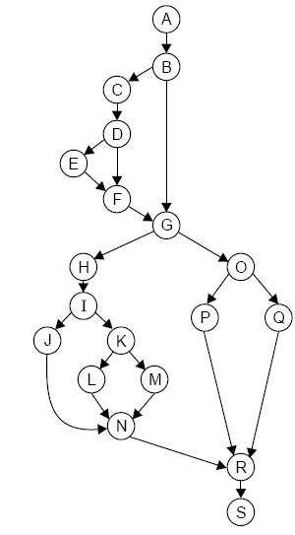
Flow graph nodes | DD Path graph corresponding node | Remarks
1 to 10 | A | Sequential nodes
11 | B | Decision node
12 | C | Intermediate node
13 | D | Decision node
14,15 | E | Sequential node
16 | F | Two edges are combined here
17 | G | Two edges are combined and decision node
18 | H | Intermediate node
19 | I | Decision node
20,21 | J | Sequential node
22 | K | Decision node
23,24,25 | L | Sequential node
DD Path graph

Slide 43
DD path graph is used to find independent paths.
We are interested to execute all independent paths at least once during path testing.
It is any path through DD path graph that introduces at least one new set of processing statements or new conditions.

Slide 44
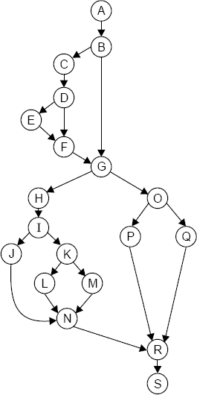
Independent paths are:
(i)
(ii)
(iii)
(iv)
(v)
(vi)
(vii)
ABGOQRS ABGOPRS ABCDFGOQRS ABCDEFGOPRS ABGHIJNRS ABGHIKLNRS ABGHIKMNRS

Slide 45
Independent paths ensures that
Every statement in the program has been executed at least once
Every branch has been exercised for true or false condition.
There are standard tools to generate DD paths.
In practice it is reasonable to make DD paths for the programs up to 100 lines of code. Beyond this , go for standard tool

Slide 46
CYCLOMATIC COMPLEXITY

Slide 47

Cyclomatic Complexity
A graph-theoretic complexity measure that highlights program complexity - lack of modularization (McCabe, 1976).
Based upon determining the number of linearly independent paths in a program module; suggesting that the complexity increases with this number, and reliability reduces.
This metric has two primary uses:
to indicate escalating complexity in a module as it is coded and therefore assisting the coders in determining the “size” of their modules,
to determine the upper bound on the number of tests that must be designed and executed.
47

Slide 48



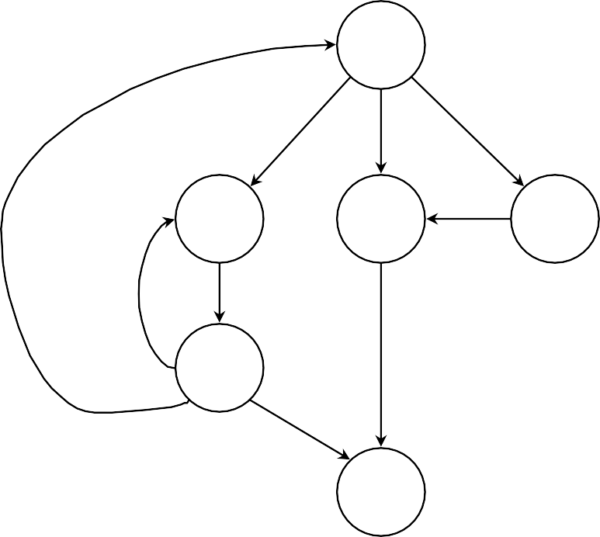
Calculating Cyclomatic Complexity (1)
Consider this flowgraph:
First count the graph elements:
Edges
Nodes
Regions
a
b
c
d
e
f
48

Slide 49

Calculating Cyclomatic Complexity (2)
Consider this flowgraph:
Edges (E) = 9
Nodes (N) = 6
Regions = 5
a
R1
R2
b
R3 R4
e
c
d
R5
f
49

Slide 50

Calculating Cyclomatic Complexity (3)
Now, the complexity can be calculated in 3 ways:
Complexity, V(G), corresponds to the number of regions.
V(G) = E - N + 2P where p is no of connected components
Complexity, V(G), is also defined as
V(G) = P + 1
where P is the number of predicate nodes
Complexity, V(G), is also defined as
V(G)=R
R: Number of regions in the control flow graph.
50

Slide 51


Calculating Cyclomatic Complexity (4)
Consider this flow graph:
Complexity for this graph is, then:
a
🗹
🗹
No. of regions = V(G)=5
V(G) = E-N+2 = 9 - 6 =5
V(G) = P + 1 = 3
R1
R2
🗷
b
R3 R4
e
c
d
WHY !!! Complexity is not same
R5
f
51

Slide 52

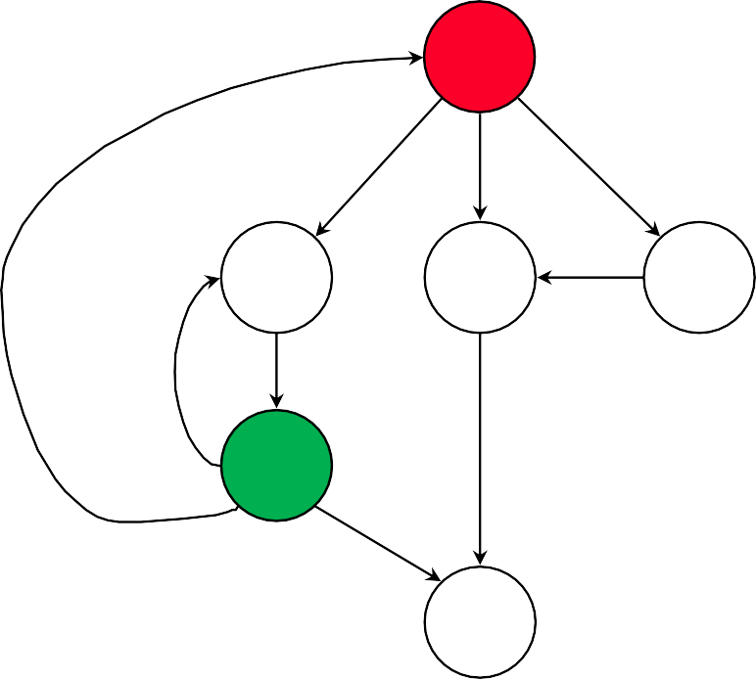
Calculating Cyclomatic Complexity (5)
Reason:
The 2 predicate nodes each have 3 outputs so have degree’s of freedom of 2 and it is these that must be added.
a
R1
R2
b
c
d
R3 R4
Complexity for this graph is, then:
No. of regions = 5
V(G) = E-N+2 = 5
V(G) = P + 1 = 5
e
R5
🗹
🗹
🗹
f
52

Slide 53
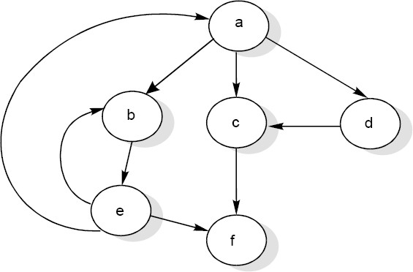
There will be five independent paths for the flow graph illustrated.
Path 1 : a c f
Path 2 : a b e f
Path 3 : a d c f
Path 4 : a b e a c f or a b e a b e f
Path 5 : a b e b e f

Slide 54


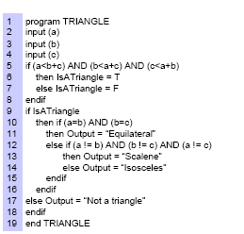
Exercise - 1
Design Control Flow Graph
Design DD Path
Calculate Cyclomatic
Complexity
Find independent paths.

Slide 55

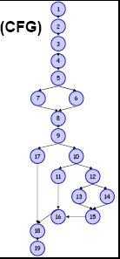
Control Flow Graph

Slide 56
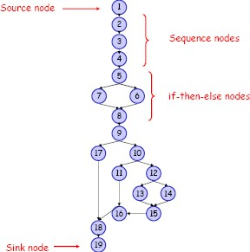

Slide 57

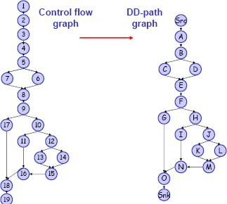
DD Path Graph

Slide 58

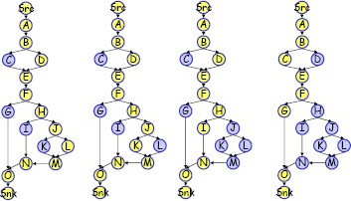
Independent Paths

Slide 59

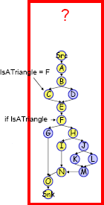
Check the feasibility of the path

Slide 60
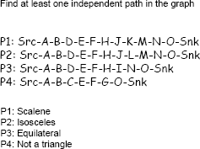
Independent Paths

Slide 61
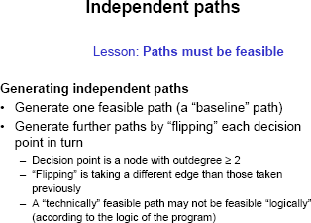

Slide 62

Finding Independent Path
To find these paths, McCabe developed a procedure known as the baseline method
The procedure works by starting at the source node.
From here, the leftmost path is followed until the sink node is reached.
If we take the example in Figure 1.7, this provides us with the path Src-A, B, D, E, F, H, J, K, M, N, O-Snk. We then repeatedly retrace this path from the source node, but change our decisions at every node with out-degree >= 2, starting with the decision node lowest in the path.
For example, the next path would be Src-A, B, D, E, F, H, J, L, M, N, O-Snk as the decision at node J would be „flipped‟.

Slide 63
Cont’d..
Two important points should be made here.
Firstly, if there is a loop, it only has to be traversed once, or else the basis will contain redundant paths.
Secondly, it is possible for there to be more than one basis; the property of uniqueness is one not required.
This now forms the basis set of paths for the graph
In theory, if we allow for the basic notions of scalar multiplication and addition, we should now be able to construct any path from our basis.
So, you can create a any new path from these set of basis paths like P6 = P1 + P3 etc.
We clearly now have a basis, which, in theory, can be rigorously
tested, thus verifying all other paths constructed from its elements.

Slide 64
However, the basis path method hides an even larger problem. When constructing the basis set of a program graph, it is possible that some of the paths that make up the basis could be infeasible. This would result in the ability to construct further infeasible paths, and could lead to testers trying to find faults in paths that cannot exist.
There do exist different solutions to this problem. Rather than just ‘flipping’ the decision at each node with out-degree ³ 2, there is first a check to see if the path is semantically legal.
Likewise, rules can be identified that can be put in place before the basis path method is executed, thus restricting the basis to feasible paths only.
Of course, both these solutions have the disadvantage of more work for the tester.

Slide 65
However, if these solutions can be implemented then the basis path method is a very elegant way of testing every decision outcome.

Slide 66

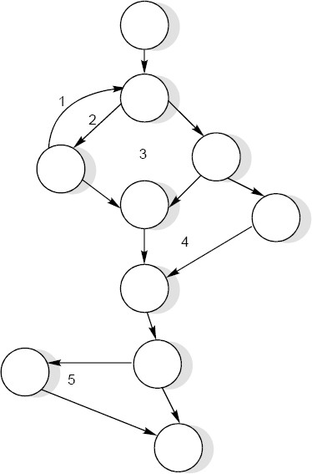
Exercise - 2
Consider a flow graph given below and calculate the cyclomatic complexity.
= e – n + 2P
= 13 – 10 + 2 = 5
V(G)

Slide 67

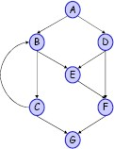
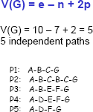
Exercise -3
Consider a flow graph and calculate the cyclomatic complexity and Independent paths.

Slide 68



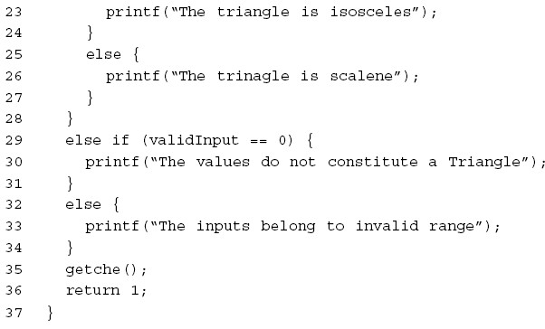
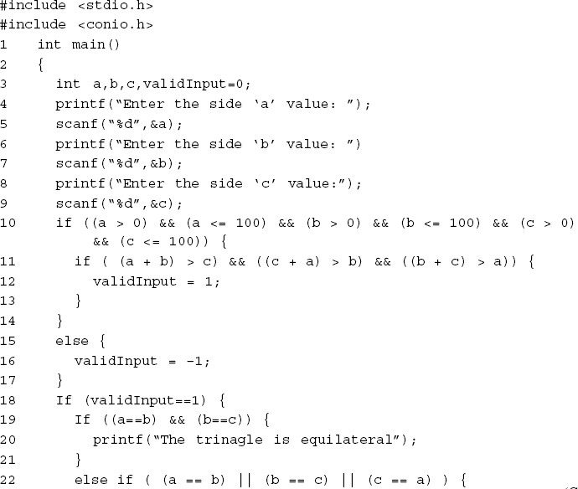
Exercise - 2
Your Task
Draw the flow graph
DD path
Find the complexity

Slide 69
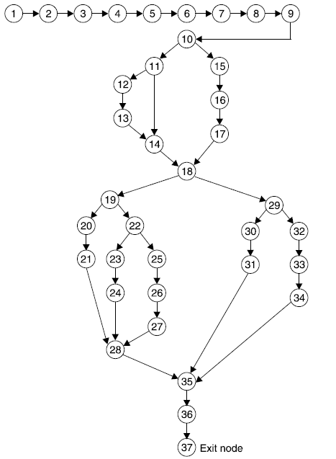

Slide 70
Flow graph nodes | DD Path graph corresponding node | Remarks
1 TO 9 | A | Sequential nodes
10 | B | Decision node
11 | C | Decision node
12, 13 | D | Sequential nodes
14 | E | Two edges are joined here
15, 16, 17 | F | Sequential nodes
18 | G | Decision nodes plus joining of two edges
19 | H | Decision node
20, 21 | I | Sequential nodes
22 | J | Decision node
23, 24 | K | Sequential nodes
25, 26, 27 | L | Sequential nodes
Cont….

Slide 71
Flow graph nodes | DD Path graph corresponding node | Remarks
28 | M | Three edges are combined here
29 | N | Decision node
30, 31 | O | Sequential nodes
32, 33, 34 | P | Sequential nodes
35 | Q | Three edges are combined here
36, 37 | R | Sequential nodes with exit node

Slide 72
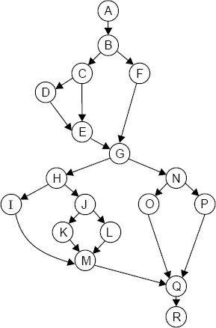
Complexity ?
Number of edges (e) = 23
Number of nodes (n) =18
V(G) = e – n + 2 = 23 – 18 + 2 = 7

Slide 73
The cyclomatic complexity is 7. Hence, there are seven independent paths
Independent paths are:
ABFGNPQR
ABFGNOQR
ABCEGNPQR
ABCDEGNOQR
ABFGHIMQR
ABFGHJKMQR
ABFGHJLMQR

Slide 74


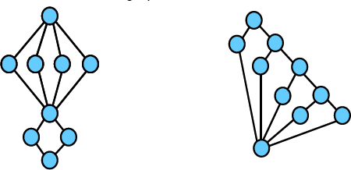
Calculating cyclomatic complexity - Excercise
Calculate the cyclomatic complexity for each of the two given graphs.
Cyclomatic complexity for first
graph; M1 =
Cyclomatic complexity for second graph; M2 =
Cyclomatic complexity for the
combined graph;
M = M1 + M2

Slide 75



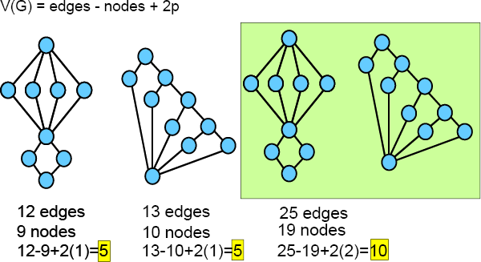
Calculating cyclomatic complexity – Exercise
…

